Slide 1
Task 2: MOBILE APPLICATION DEVELOPMENT PROCESS
PRESENTED BY
ETHE ENAME­ (SENG22SE015)
ETIKWE RAMPSON (SENG22TE004)
AGBOR AYAMBA (SENG22TE002)
COURSE TITLE: Internet Programing COURSE INSTRUCTOR
& DR. VALERY NKEMINI
Mobile programming

Slide 2
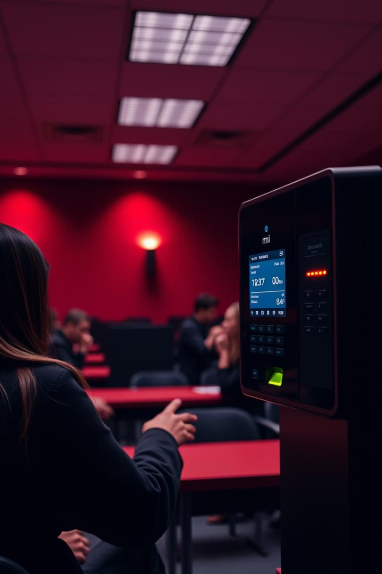
Requirement Gathering for Biometric Student Attendance Project
In this presentation, we will explore the critical phase of Requirement Gathering for developing a biometric student attendance system. This phase is essential to ensure the final system effectively captures accurate attendance while addressing users' needs and concerns.
We will cover stakeholder identification, data collection techniques, data quality assurance, and evaluating user acceptance challenges to build a robust project foundation.

Slide 3

Stakeholder Identification
Students
The end users whose attendance will be recorded using biometric methods. Their cooperation and comfort with the system are critical.
Faculty & Instructors
Those responsible for monitoring attendance and ensuring academic integrity through authentic presence tracking.
Administrative Staff
Manage records, validate attendance data, and integrate with institutional reporting systems.
IT and Maintenance Team
Provide technical support, system upkeep, and address any biometric hardware or software issues.

Slide 4

Requirement Gathering Techniques
Surveys
Distribute questionnaires to gain broad input on user expectations and potential concerns regarding biometric attendance.
Interviews
One-on-one discussions to capture detailed requirements and preferences from key stakeholders.
Brainstorming
Collaborative sessions to generate ideas and identify possible system features and constraints.

Slide 5
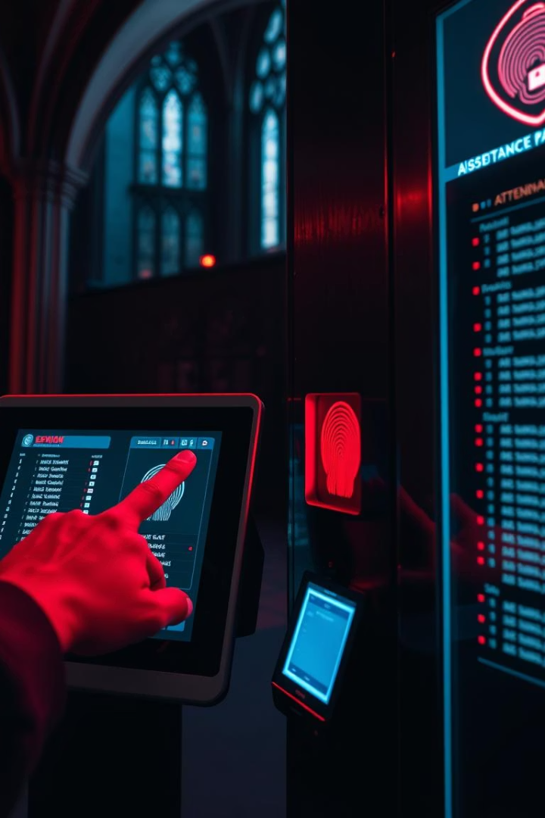




Data Gathering Process
Collect Raw Biometric Data
Capture finger, face, or iris data from students as initial identification input.
Attendance Event Recording
Log the timestamped biometric matches during class sessions.
Data Aggregation
Combine biometric inputs with student records and class schedules for correlation analysis.
Initial Verification
Check attendance logs for anomalies or mismatches for further review.

Slide 6
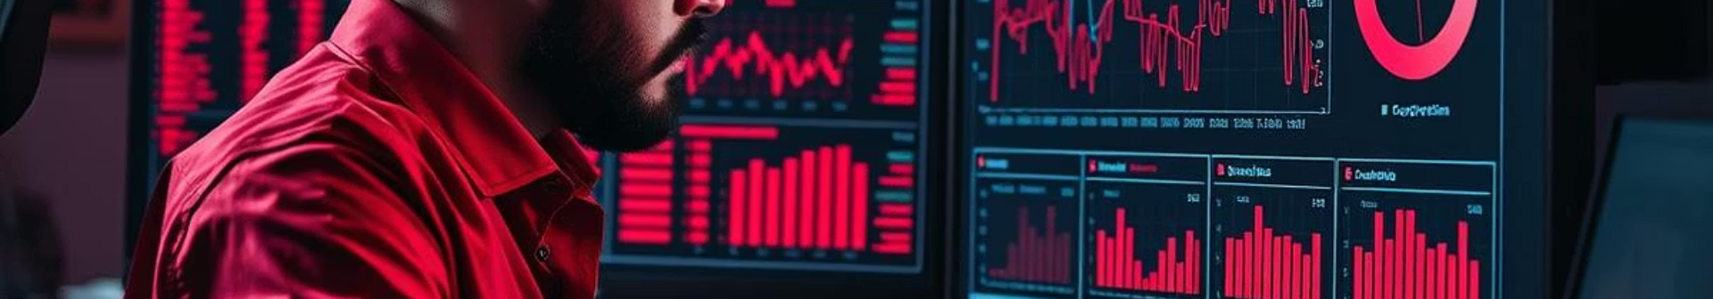
Data Cleaning and Validation
Validate Against External Records
Normalize Data Formats
Remove Noise and Errors
Identify Inconsistent Entries
Cross-check with manual attendance logs or enrollment data for improved reliability.
Ensure uniform recording of biometric attributes and attendance metadata.
Filter out false positives and sensor misreads that could compromise data accuracy.
Locate duplicate or missing biometric records and incorrect timestamps.

Slide 7
User Reluctance Assessment
Privacy Concerns
Technical Trust
Change Resistance
Legal and Ethical Factors
Reluctance to adopt technology perceived as intrusive or prone to errors or failures.
Users may worry about how biometric data is stored, accessed, and protected.
Preference for traditional attendance methods and discomfort with new procedures or devices.
Concerns about compliance with data protection laws and ethical use of biometric information.

Slide 8

Strategies to Mitigate User Reluctance
1
Transparency
2
Consent and Control
Clearly communicate data collection purposes, security measures, and user rights.
Allow users to provide informed consent and control over their biometric data usage.
3
System Reliability
4
User Training and Support
Ensure high accuracy and provide fallback manual attendance options to build trust.
Offer educational sessions to ease the transition and address user concerns efficiently.

Slide 9
Summary and Next Steps
Key Takeaways
Next Steps
Thorough stakeholder identification ensures all voices are heard.
Finalize and document detailed system requirements.
Design prototype interfaces incorporating stakeholder input.
Diverse gathering techniques yield comprehensive, validated requirements.
Plan pilot testing phases with live biometric data capture.
Careful data cleaning maintains system accuracy and trust.
Develop user education and communication strategies.
Addressing user reluctance is essential for smooth adoption.

